Slide 1
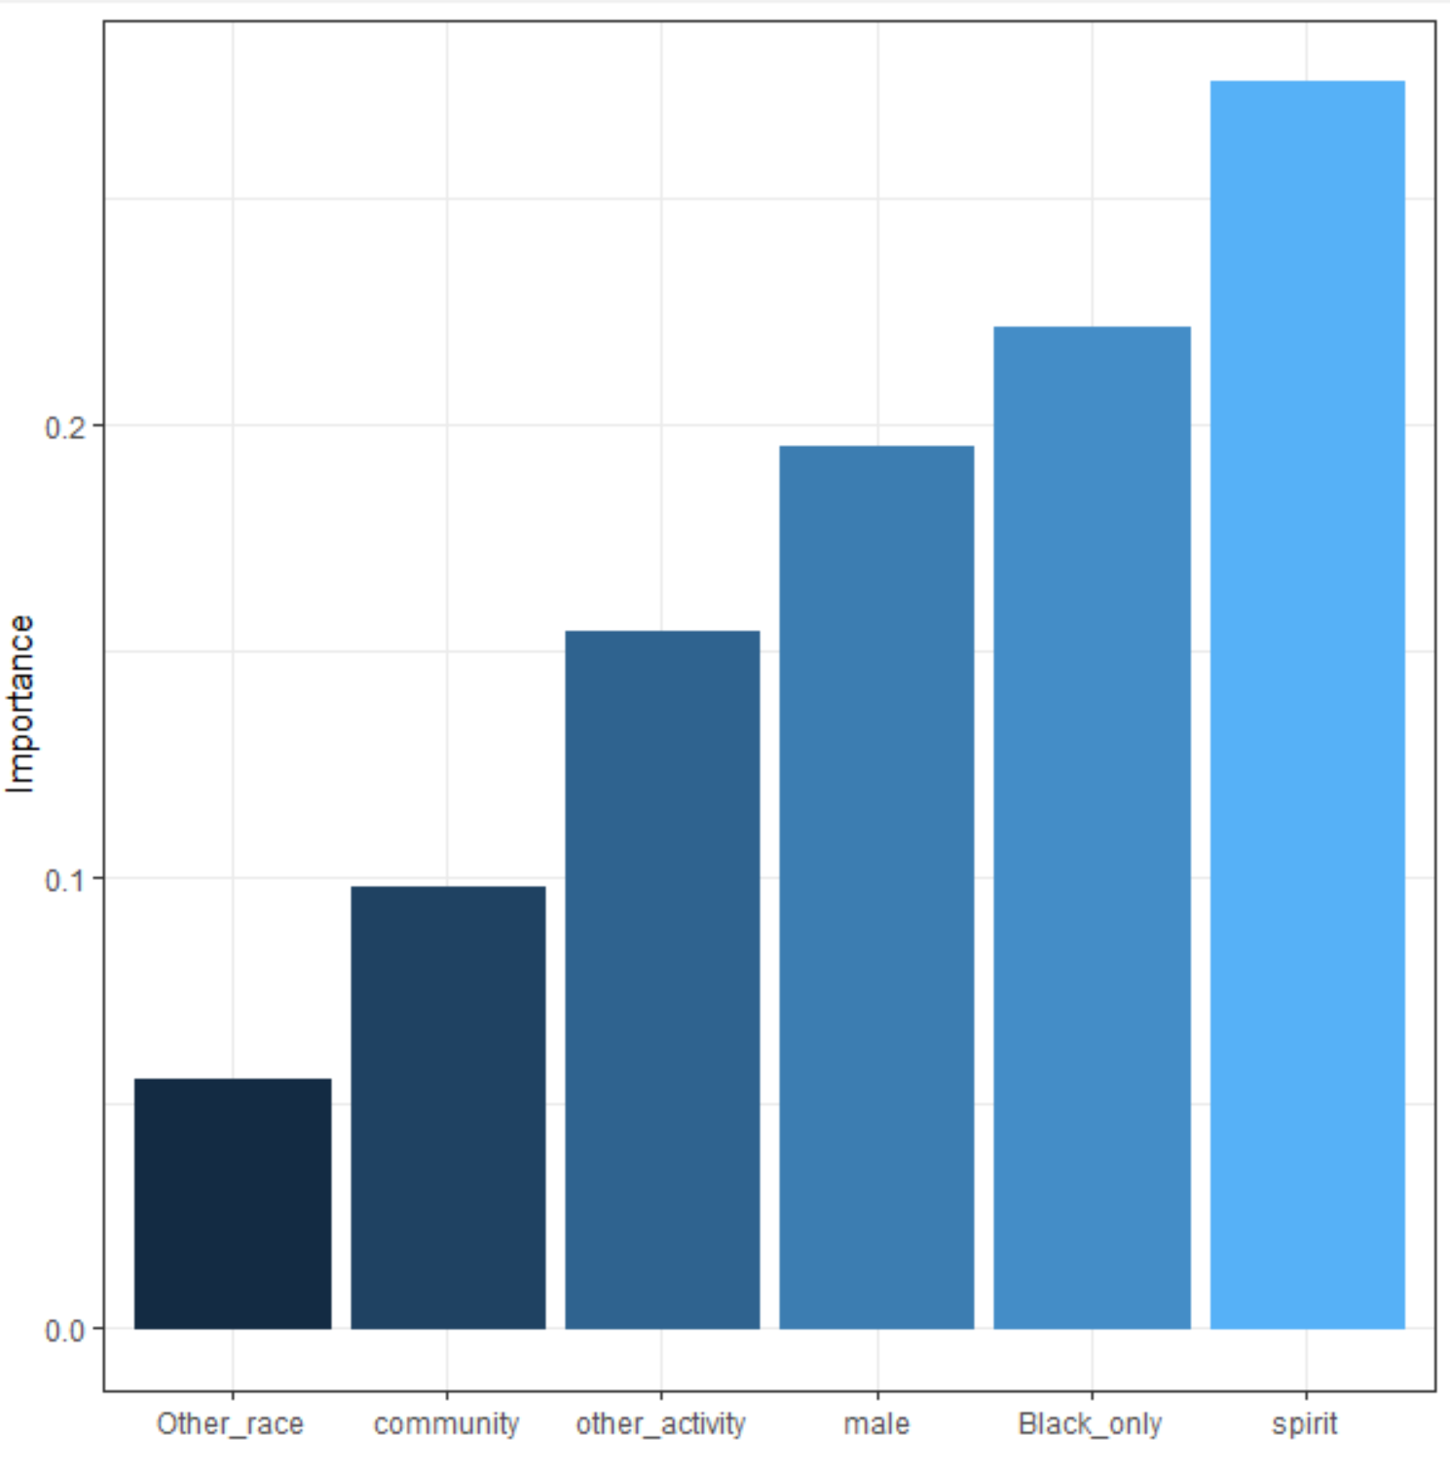
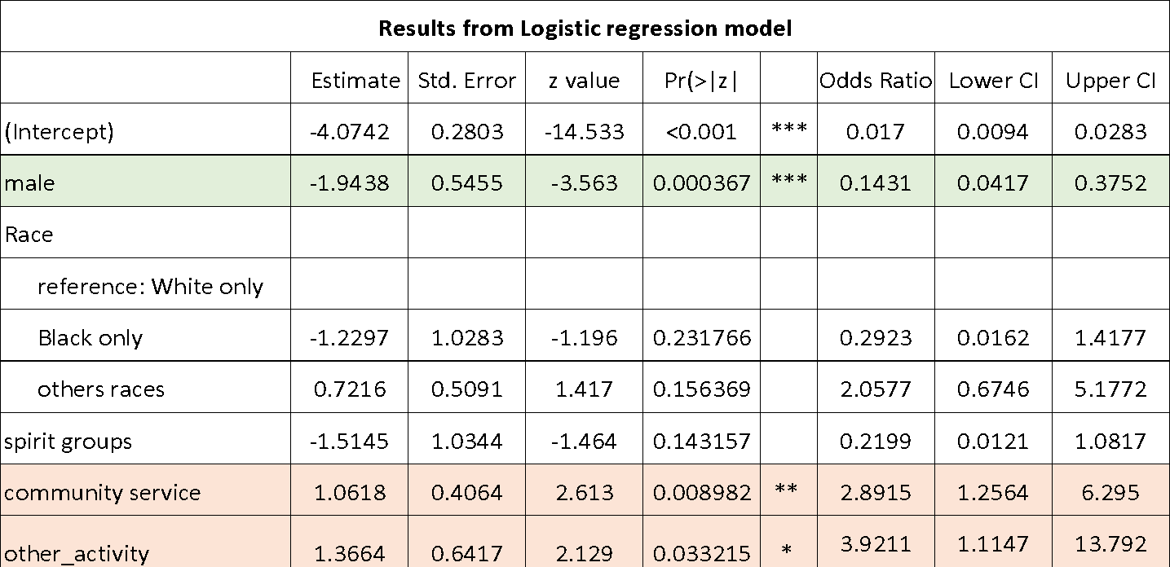
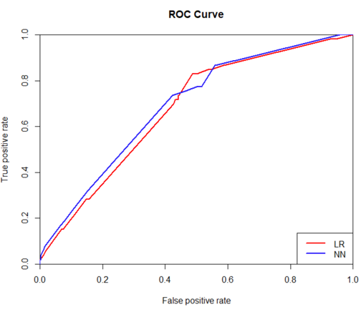

Predictive Models for Cyber Bullying in Middle and High School Students
Background
Results
Conclusion
Cyber bullying takes place over digital devices through text, apps, social media, forums or gaming where people can view, participate in, or share content. It includes sending, posting, or sharing negative, harmful or false content, which usually causes embarrassment or humiliation, and sometimes even leads to serious long-lasting problems. Unlike other kinds of bullying, it can be particularly damaging and upsetting because it's usually anonymous or hard to trace. With increasing prevalence of social network among teenagers, cyber bullying becomes more critical for us to be aware of and take preventive actions against it.
According to the SCS codebook, of the 9,372 NCVS respondents eligible for the SCS supplement, 5,469 (58.4%) completed the SCS interview. This 5,469 is the sample size used in this study. From stepwise Logistic regression analysis, five variables were kept in the predictive model, including male gender, race, participating in community activities etc.; The Area Under the Curve (AUC) for the Receiver Operating Characteristics indicated good performance of the model. ANN model also had good performance with a similarly high AUC. From the Odds Ratios, boy students are less likely (14% likely) to experience cyber bullied than girls (OR<1), while participating in community service or other activity is associated with a higher likelihood of being cyber bullied (OR>1). For racial differences, although there were differences in descriptive data (i.e, 1.8% vs 0.7% vs 2.5%), when testing them in the model, differences did NOT reach statistical significance because in the model, the race groups had p-values larger than 0.05. The AUC is 0.77 for training sample according to above logistic regression, and 0.79 for the NN model.
Using data from the NCVS, the prevalence of cyber bullying was examined among middle and high school students, and prediction models were developed and validated with good performance, with AUC of 0.77 and 0.79 respectively. Results showed there were certain student characteristics such as gender, race, and engagement in certain activities were related to cyber bullying, which would help us effectively take preventive measures against the behaviors.
Discussion
Table 1 Students characteristics.
Table 2 Cyber Bully characteristics.
In the usage of the data from NCVS, the variable “School Type” was not included in the models due to too many missing values for it. If the quality of this variable could be improved enough to be included, the performance of the predictive model might be further improved, as school type is likely strongly related with students’ experience at school.
The data was taken with a self-reporting format, where the participants would decide themselves whether the cyber bullying behaviors occurred. There are several ways the quality of the data can be further improved by addressing this particular issue. 1) the question of cyber bullying could be framed not as a single question, but rather as a set of questions that leads to a tally of total score which is used in turn to decide whether the behaviors qualify as cyber bullying action or not. 2) rather than framing in a yes or no question, the participants could be provided with a scale of 1 to 10 to rate the questions. Thus, the participants could be given a scale where they could rate the behaviors themselves, while being given a set of behavior questions where a more subjective view or a more structured answer could be derived. Through the comparison of their own answers against the derived answers, further insights could be driven from the calculation of this “hit rate” which could in turn to be fed into the learning model.
The study can also to be extended to adults online. The nature of cyber bullying also needs to be better understood as the power structure on the internet is very different and one needs to be carefully considering what means to be of the same strength or power.
Further studies could take some consideration in whether the current data setting is most suitable for training in ANN where there is a hidden layer between the input layer and output layer. As this relationship proves to be nonlinear, multi-layer neural network appears to be more suitable in this pursuit.
Proportion by Age
12 | 15%
13 | 17%
14 | 16%
15 | 15%
16 | 16%
17 | 14%
18 | 8%
Proportion by Gender
Female | 49%
Male | 51%
Proportion by Race
White only | 78.2%
Black only | 12.5%
others | 9.3%
Proportion by Ethnicity
Hispanic | 25%
Non-Hispanic | 75%
Proportion by School Type
Public | 93%
Private | 7%
Proportion of Cyber Bully by Age
12 | 1%
13 | 1.6%
14 | 2.0%
15 | 2.4%
16 | 1.9%
17 | 1.4%
18 | 1.7%
Proportion of Cyber Bully by Gender
Female | 0.7%
Male | 2.8%
Proportion of Cyber Bully by Race
White only | 1.8%
Black only | 0.7%
Others | 2.5%
Proportion of Cyber Bully by Ethnicity
Hispanic | 1.9%
Non-Hispanic | 1.1%
Figure 2. Relative Importance of
Variables in NN Model
Objective
The purpose of this study is to build predictive model of cyber bullying among middle and high school students in the United States. With the model, we could identify student personal and context characteristics that are associated with experiencing cyber bullying, and take further preventive measures.
2.8%
0.7%
Data
This study used data from the 2015 National Crime Victimization Survey (NCVS): School Crime Supplement (SCS) for students 12 to 18 years of age. NCVS is conducted by the United States Department of Justice and examines the nature and extent of crime nationwide. The SCS is a supplemental survey linked to the NCVS survey response and assesses school-related victimization. In 2015, household members aged 12 to 18 years from nationwide were given an SCS interview, following a completed NCVS interview. Information from SCS can inform professionals involved in research, policy, and any other work with crime and safety at school.
From the model, it can be seen that some of the most important factors associated with cyber bullying experience include participating in spirit groups, Black only race, male gender etc..
Table 3. Table of Coefficients and Odd Ratios from the Logistic Regression Model
Method
Figure 1. ROC Curve for the LR and NN Model
Predictive models were developed and tested using stepwise logistic regression analysis and artificial neural network (ANN). Potential predictors tested include demographic characteristics and student’s participation in different school activities.
Data was split into two random samples: a 75% training sample for developing the model, and a 25% testing sample for validating/testing the model.
Reference
1. Refer to National Crime Victimization Survey (NCVS): School Crime Supplement (SCS) https://nces.ed.gov/programs/crime/index.asp for statics information
2. Evaluation of Predictive Models. Decision Systems Group, Brigham and Women’s Hospital Harvard Medical School.
3. Garson, G. D. Interpreting neural network connection weights. Artif. Intell. Expert 6, 46–51 (1991).
4. Ben-Joseph, E. P. (Ed.). (2018, April). Cyber bullying (for Teens) - Nemours KidsHealth. Retrieved from https://kidshealth.org/en/teens/cyberbullying.html

